Slide 1

RUMYPET(R U my pet?)
Week 13
Team Groza
Kim Tae Hong (20132335)
Kim Chan Il (20150577)
(Presenter) Paeng Jin Wook (20154645)

Slide 2

Contents
Schedule & Progress
Problems & Solutions
Plans
Q&A

Slide 3
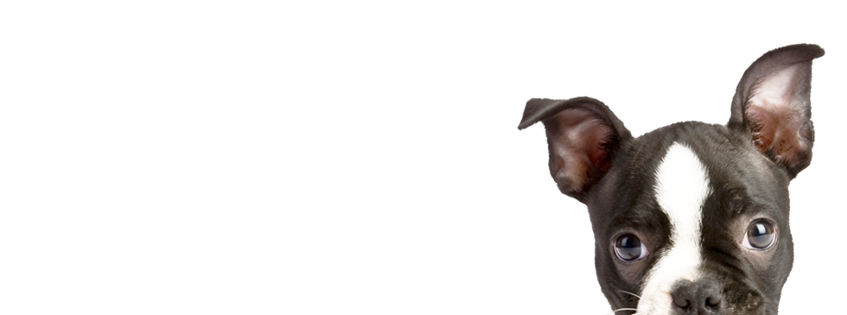
1. SCHEDULE & PROGRESS

Slide 4
SCHEDULE
Week |  | To-Do (can be changed)
Week 9 |  | Hold a meeting and make a Plan based on Midterm Demonstration.
Week 10 |  | Android : Image Upload Function. Server : Add a image data column in database and link with python code. Python : Link to the server
Week 11 |  | Android : E-mail Certification function. Server : link to python code completely and buy a server. Python : Find the way to save the feature template in database.
Week 12 |  | Android : Complete the detail function. (Edit Profile, etc...) Server : Divide the mode of the function in server. Python : Code refactoring and enhance the performance.
Week 13 |  | Android : Release the Beta Version and unit testing by users. Server : move the data to the database that we bought, and refactor. Python : Code refactoring and enhance the performance.
Week 14 |  | Final Demonstration
Week 15 |  | Report Submission
Week 16 |  | Survey & Final Arrangment
4
Notes:
This is the schedule later.

Slide 5
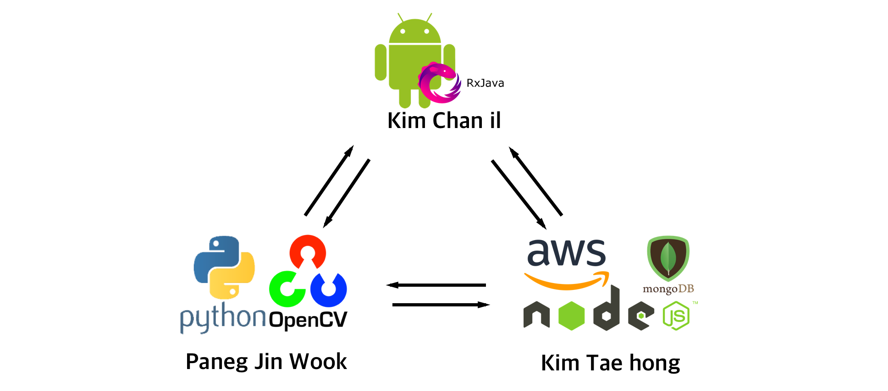
Role of this week
Week 13 |  | Android : Release a Beta Version and Unit testing by users. Server : Move the data to database that we bought, and refactor. Python : Code refactoring and enhance the performance.
5

Slide 6




Schedule & Progress – Android & Server
“We complete most of the functions to release the Beta version in Android”
6
Notes:
This is the UI Deisign we did last week.
Using this, Chan il Kim applied this into Android Studio.

Slide 7

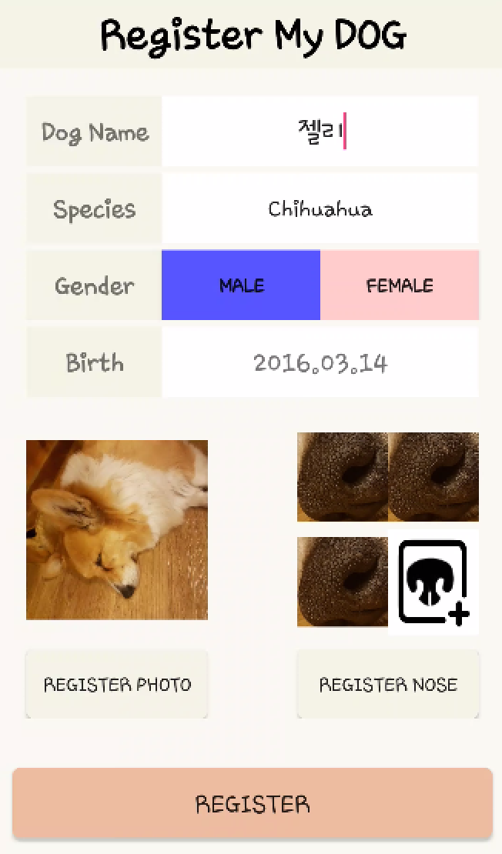


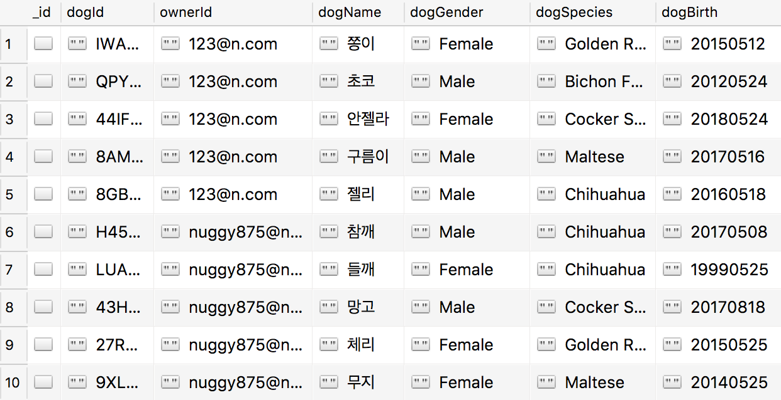
Schedule & Progress – Android & Server
“When user register the dog, the informations are saved in MongoDB”
6
Notes:
This is the UI Deisign we did last week.
Using this, Chan il Kim applied this into Android Studio.

Slide 8


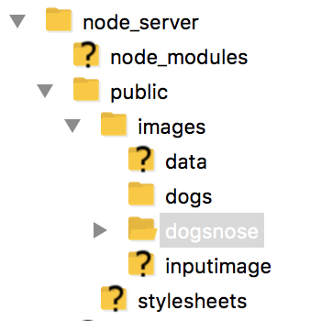
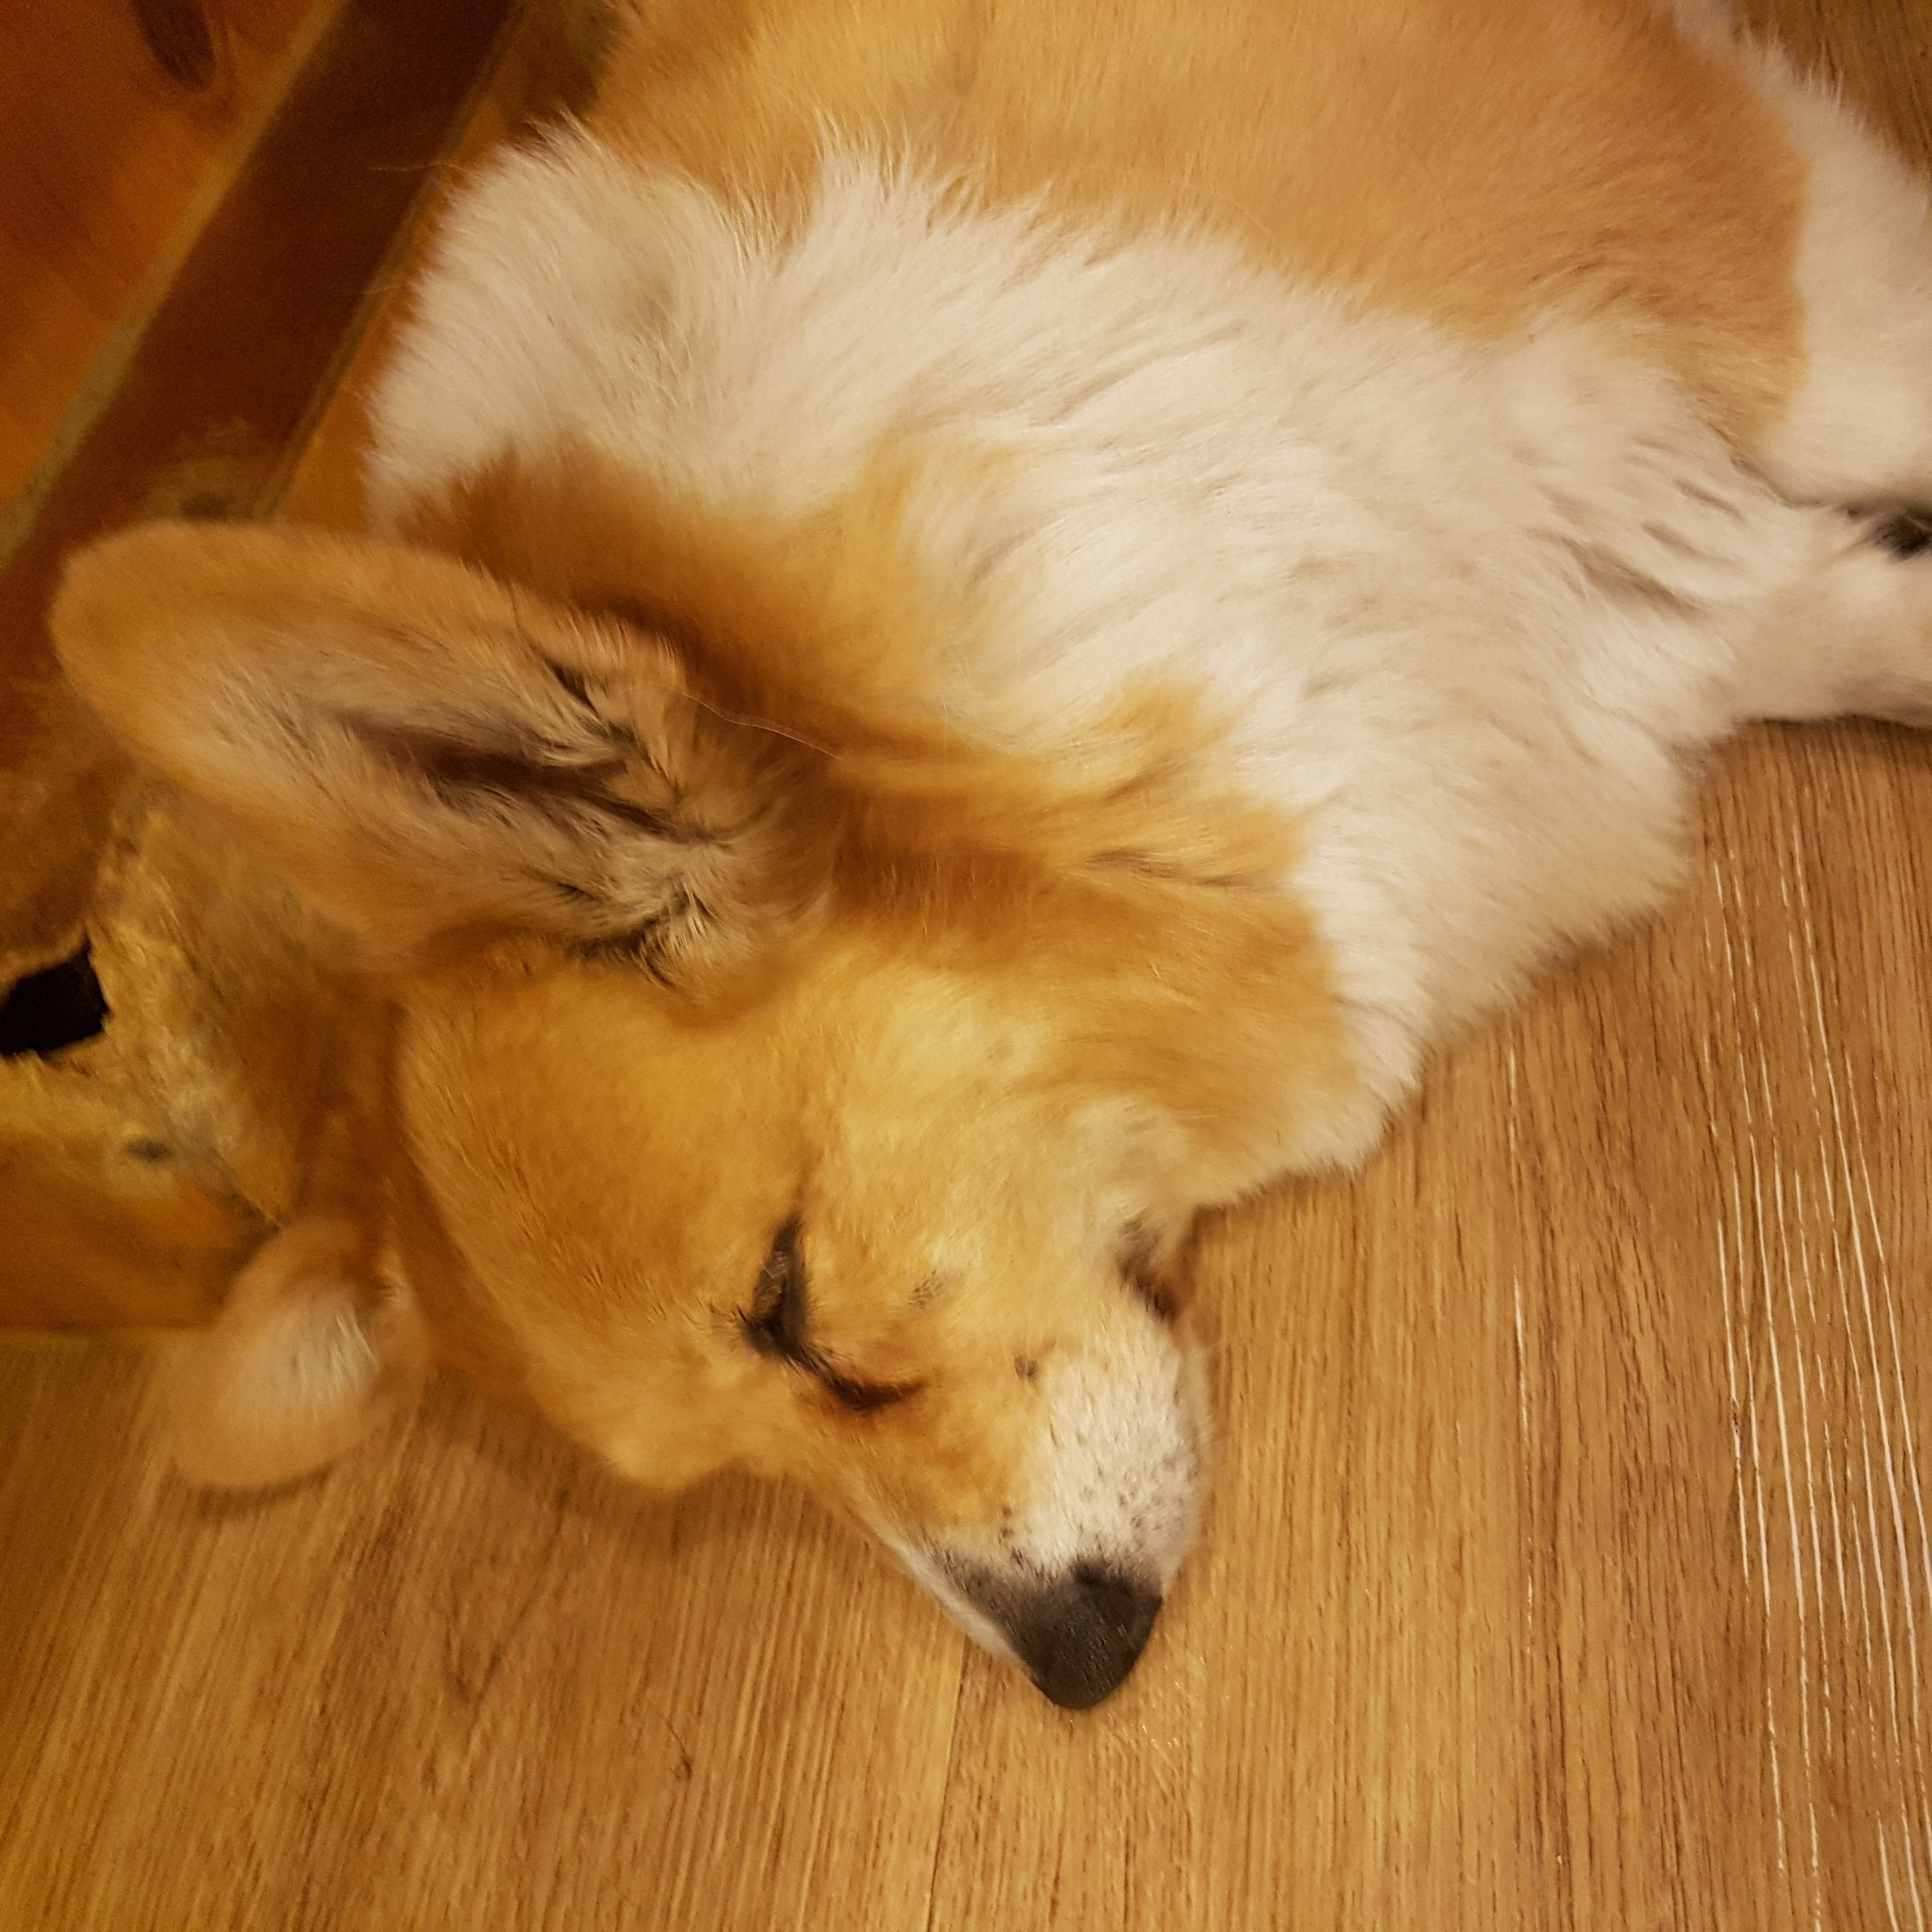
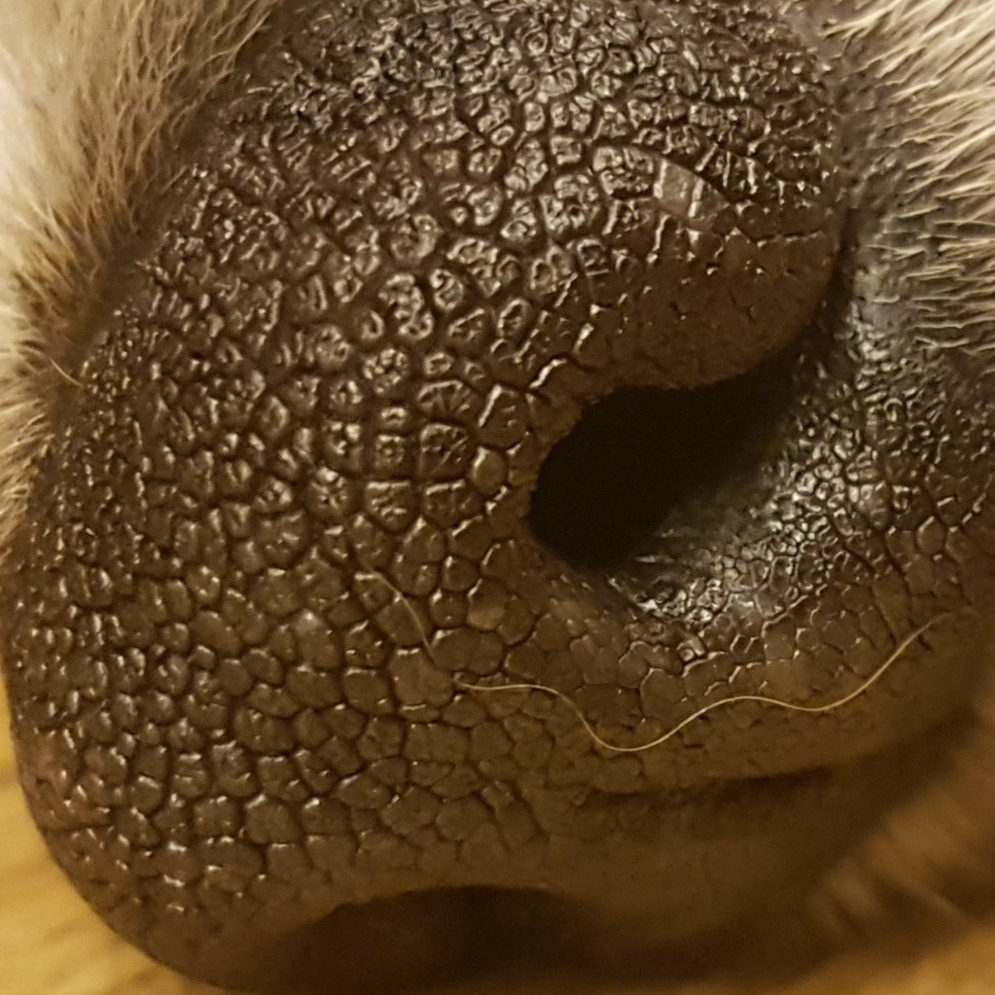
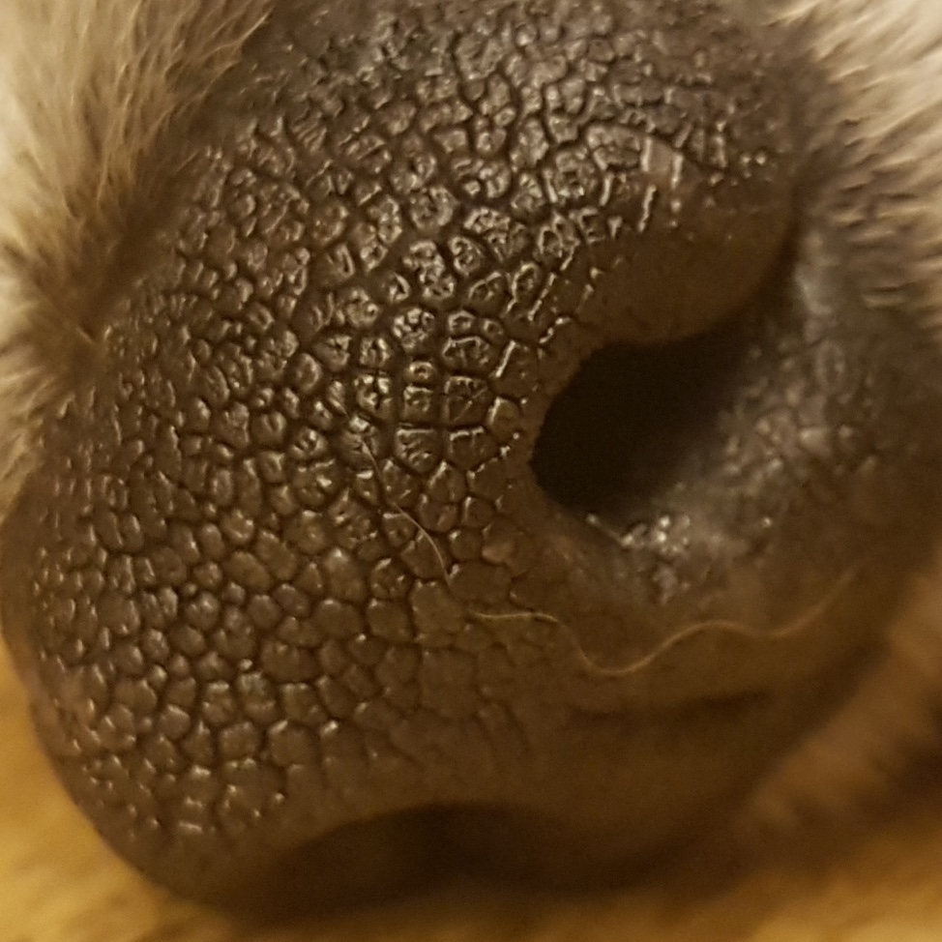
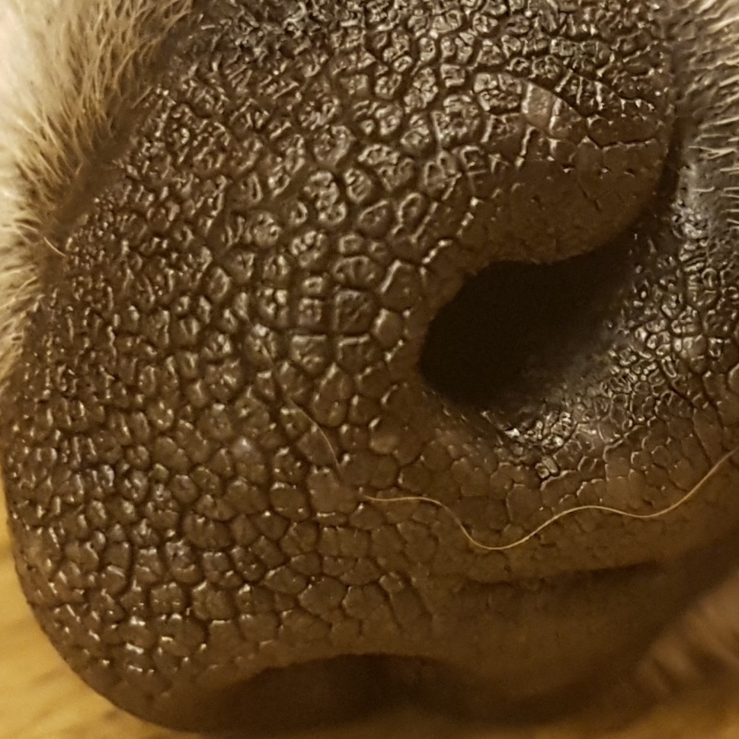
Schedule & Progress – Android & Server
“The images are saved in Local Storage of Server by Dog ID (random String)”
7
Notes:
This is the UI Deisign we did last week.
Using this, Chan il Kim applied this into Android Studio.

Slide 9

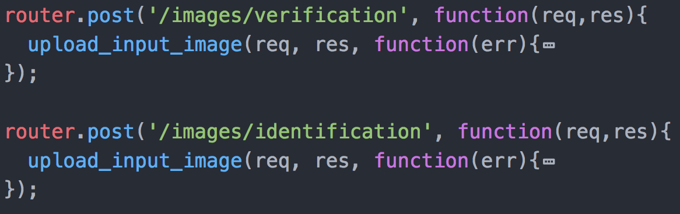
Schedule & Progress – Server
“Divide router for MODE 1(Verification) and MODE 2(Identification)”
7
Notes:
This is the UI Deisign we did last week.
Using this, Chan il Kim applied this into Android Studio.

Slide 10
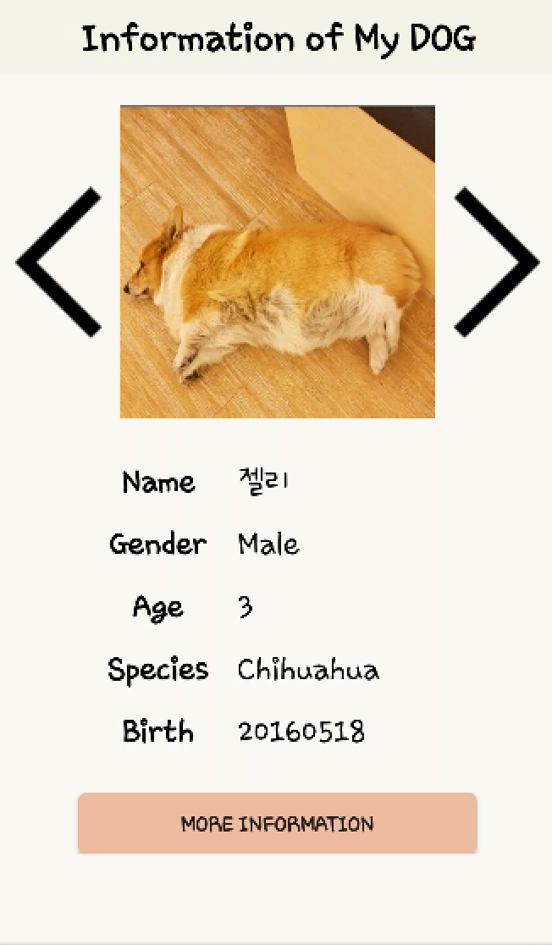

Schedule & Progress – Server (in mode 1)
“MODE 1 need verification to get your dog’s private information”
Taking picture
“True” or ”False”
7
Notes:
This is the UI Deisign we did last week.
Using this, Chan il Kim applied this into Android Studio.

Slide 11
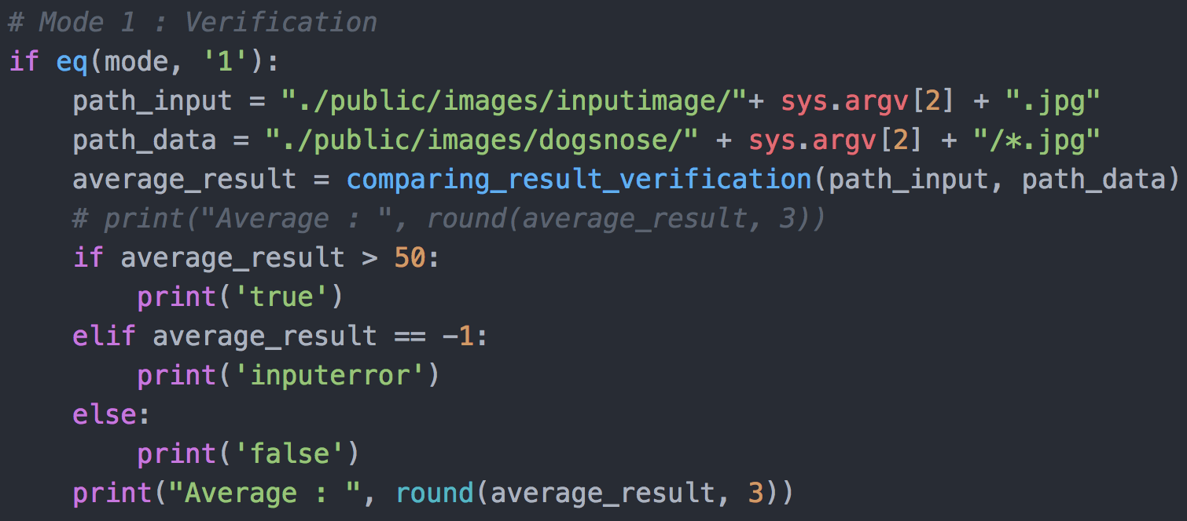
Schedule & Progress – Python (in mode 1)
“In Python for MODE 1, if the average of the result is over than 50,
it returns ‘True’, and if below, it returns ‘False’ ”
Input Image
“50 is based on many performance test”
7
Database
Notes:
This is the UI Deisign we did last week.
Using this, Chan il Kim applied this into Android Studio.

Slide 12
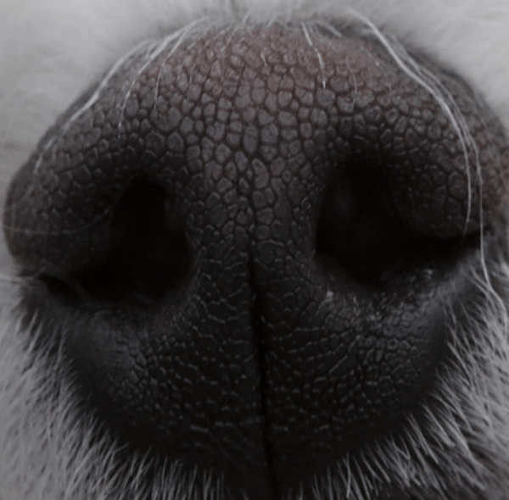
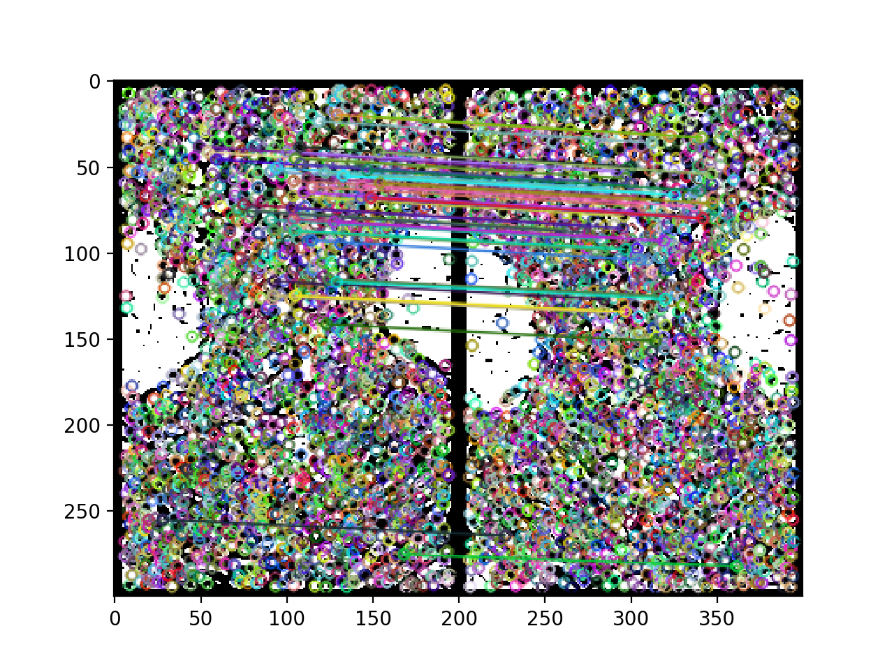
Schedule & Progress – Python (in mode 1)
“We used the Preprocessing method that we have developed.
But We didn’t have a progress in improving Feature matching Method (SIFT) ”
Pre-processing Method
Feature Matching Method
7
(SIFT)
Notes:
This is the UI Deisign we did last week.
Using this, Chan il Kim applied this into Android Studio.

Slide 13
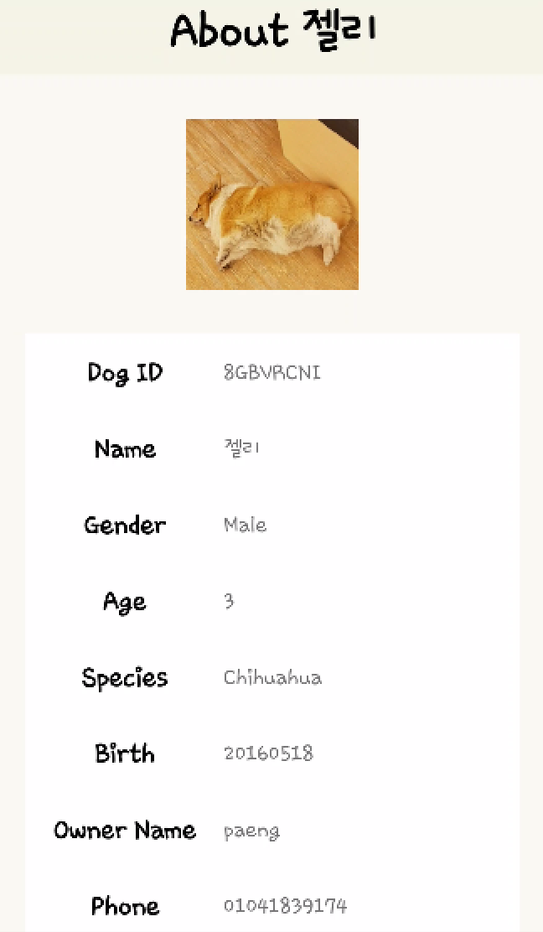
Schedule & Progress – Android (in mode 1)
“If TRUE, it will show you the dog’s private information in detail”
“True”
7
Notes:
This is the UI Deisign we did last week.
Using this, Chan il Kim applied this into Android Studio.

Slide 14
Schedule & Progress – Android (in mode 1)
“If FALSE, it will show you Nothing”
“False”
“Verification Failed”
7
Notes:
This is the UI Deisign we did last week.
Using this, Chan il Kim applied this into Android Studio.

Slide 15
Schedule & Progress – Android (in mode 1)
“If FALSE, it will show you Nothing”
“False”
“Verification Failed”
7
Notes:
This is the UI Deisign we did last week.
Using this, Chan il Kim applied this into Android Studio.

Slide 16
Schedule & Progress – Server (in mode 1)
“MODE 2 is a process to find the dog’s information by unknown dog’s image”
Taking picture
“True” or ”False”
7
Notes:
This is the UI Deisign we did last week.
Using this, Chan il Kim applied this into Android Studio.

Slide 17
Schedule & Progress – Server (in mode 1)
“MODE 2 is a process to find the dog’s information by unknown dog’s image”
Taking picture
“True” or ”False”
7
Notes:
This is the UI Deisign we did last week.
Using this, Chan il Kim applied this into Android Studio.

Slide 18
Schedule & Progress – Paeng Jin Wook (Python)
“Captured the Video and Saved the Image”
12

Slide 19
Schedule & Progress – Kim Chan Il (Android)
“Captured the Video and Saved the Image”
12

Slide 20
2. PROBLEMS & SOLUTION

Slide 21
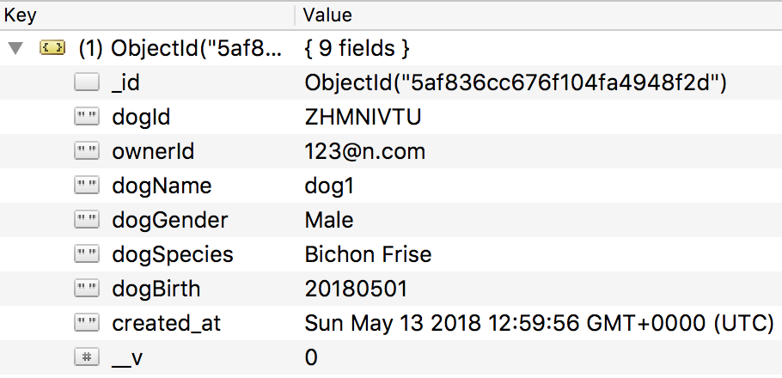
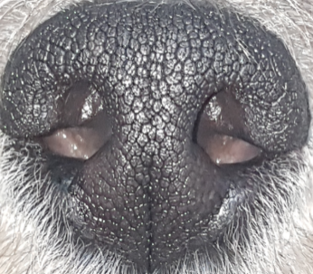
PROBLEMS & SOLUTIONS
Problem 1
When we upload a image in MongoDB as a column, We had some Problem...
Input Image
14
Notes:
--ppt reading--
Now, we have our own server!

Slide 22

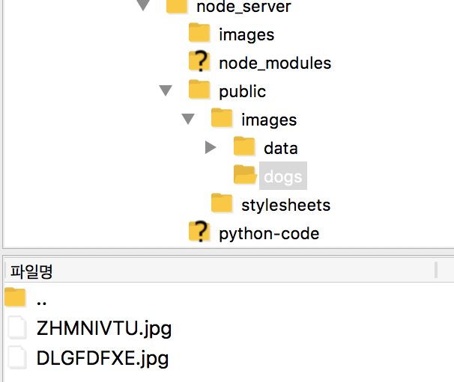
PROBLEMS & SOLUTIONS
Solution 1
We Save it at the local path of the server so that we can later also use it in a python code.
Input Image
15
Notes:
--ppt reading--
Now, we have our own server!

Slide 23
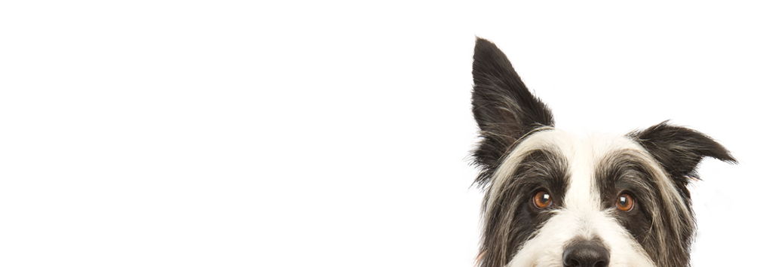
3. PLANS

Slide 24
PLANS for next week
Week 14 | Final Demonstration
17
Notes:
ppt reading

Slide 25
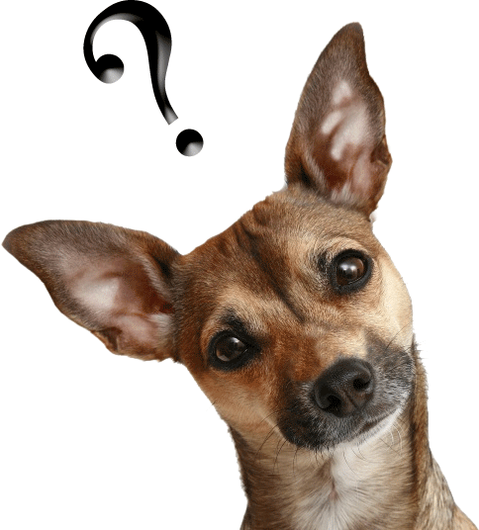
Q&A

Slide 26
Thank you!

